Slide 1

Challenge 9
Information Delivery Document Governance
The Governors

Slide 2

Challenge Overview
Challenge Overview
Approach
Solution
Benefits
Next Steps
Q&A
Problem Statement:
“I want to collect and govern the documents delivered on a project as per the MIDP, ISO standards and programme”
Notes:
MIDP = big list of everything have delivered & will deliver. Part of ISO19650, BIM Level 2 we must adhere to
Traditionally managed via Excel – gets very messy, quickly non-compliant with ISO19650. Very hard to track what’s happened.
Waste LOTS of time understanding what’s where & don’t actually know progress of delivery
Automate as much as possible. Get in line with ISO19650. Clarity around what’s actually status of delivery

Slide 3


The Governors Why did we choose this challenge?
Challenge Overview
Approach
Solution
Benefits
Next Steps
Q&A
Michael Keeley
Digital Consultant - Mott MacDonald
Jessica Hyland
Assistant Project Manager - Octavius Infrastructure Ltd
Umar Khalid
Digital Consultant - Mott MacDonald
Grant Mills
Bartlett Faculty Lead for Health
Prof Healthcare Infrastructure Delivery - UCL

Slide 4
Pain Points
Challenge Overview
Approach
Solution
Benefits
Next Steps
Q&A
Manual collation and cataloguing
Lack of integration with existing tools
Awkward interface
Non-alignment with MIDP
Non-conformance with ISO Standards
Manual folder structure creation for each project
Notes:
MIDP = big list of everything have delivered & will deliver. Part of ISO19650, BIM Level 2 we must adhere to
Traditionally managed via Excel – gets very messy, quickly non-compliant with ISO19650. Very hard to track what’s happened.
Waste LOTS of time understanding what’s where & don’t actually know progress of delivery
Automate as much as possible. Get in line with ISO19650. Clarity around what’s actually status of delivery

Slide 5
Approach
Challenge Overview
Approach
Solution
Benefits
Next Steps
Q&A
Kanban Framework:
To do
Power Automate script in SP
In Progress
Activity Dependencies
PowerBI Dashboard
Link Python validation
Diagram showing CDE workflow
Diagram showing permissions
Set up Power BI Workspace
WIP / Approval folders in SP
Python script link to MIDP
Draft Slides
Done
Create programme
Create sharepoint site
Create folder structure
Error Page
Count of docs to be delivered in next 7 days
Count of late docs
File against MIDP validation
Error Page
Count of docs to be delivered in next 7 days
Count of late docs
Slideshow Finalise
Validation Dashboard
Identified team skillset
Regular contact with challenge owner
Identified Technology Stack
Created outline of system architecture

Slide 6
System Architecture
Challenge Overview
Approach
Solution
Benefits
Next Steps
Q&A

Slide 7
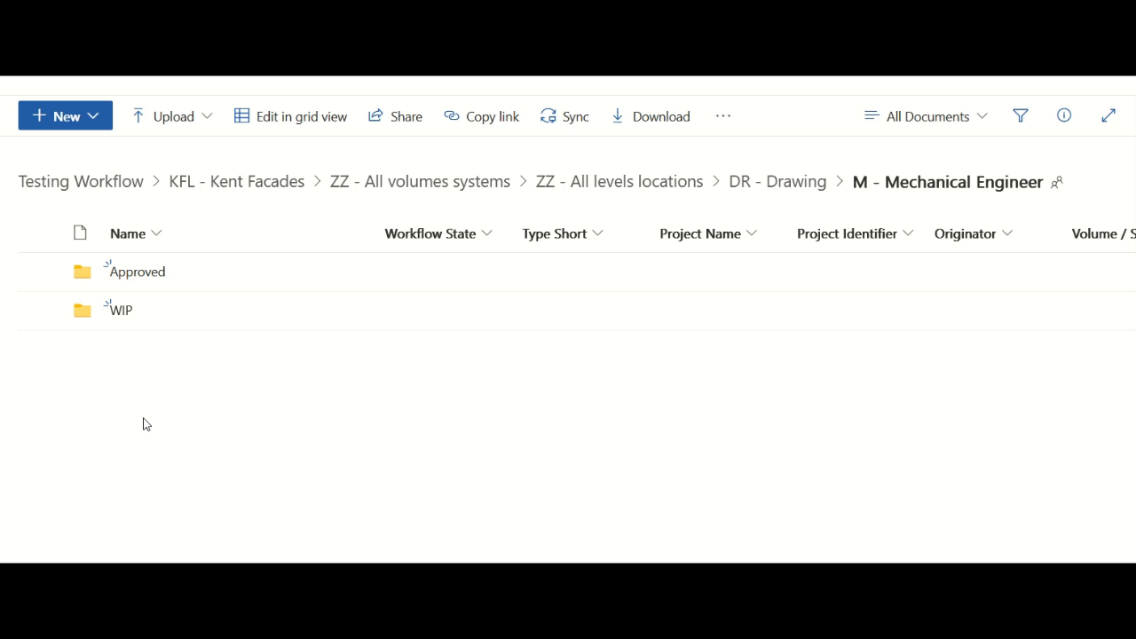
Document Repository
Challenge Overview
Approach
Solution
Benefits
Next Steps
Q&A

Slide 8
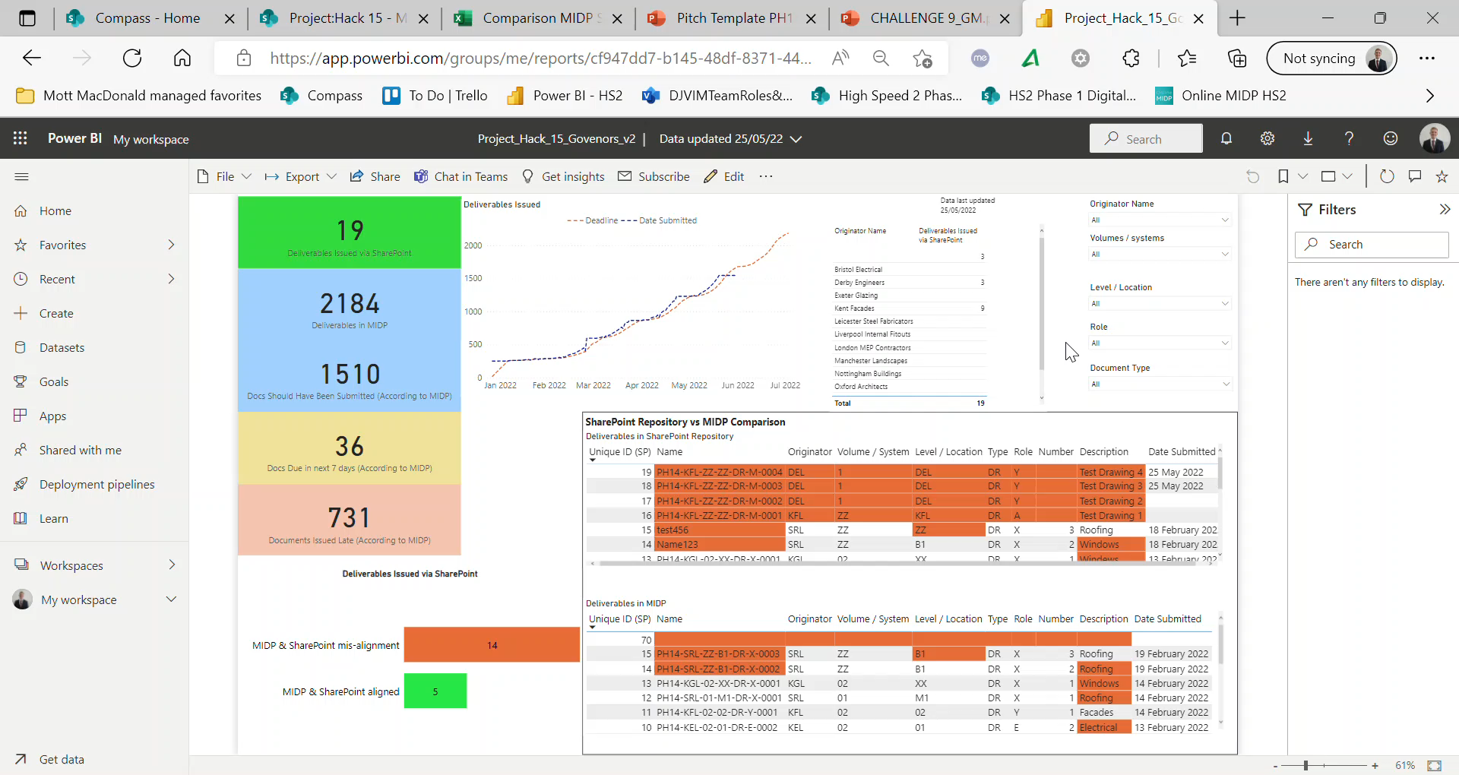
Validation Dashboard
Challenge Overview
Approach
Solution
Benefits
Next Steps
Q&A

Slide 9

Benefits
Challenge Overview
Approach
Solution
Benefits
Next Steps
Q&A
Quality Inputs - Ensures all parties are compliant with ISO19650 from the moment of data creation
Central SharePoint repository is quick & easy to use – Time Saving, Single Source of Truth
Accuracy – 3 tiered approach to ensuring quality: user selects data inputs, automated validity checks, Dashboard to view analysis
Confidence – managers can quickly & easily understand delivery status
Notes:
No single point of failure:
Dropdowns so data validated or if that fails:
Based on doc name, populating additonal info, or if that fails:
Got power bi to view validity

Slide 10
Next Steps
Challenge Overview
Approach
Solution
Benefits
Next Steps
Q&A
Host data in a cloud SQL database.
Use Power Automate to automatically notify relevant users of document submissions.
Integrate with project programme such as Primavera cloud using API.
Notes:
No single point of failure:
Dropdowns so data validated or if that fails:
Based on doc name, populating additonal info, or if that fails:
Got power bi to view validity

Slide 11
Judge’s Questions
Challenge Overview
Approach
Solution
Benefits
Next Steps
Q&A
If documents need to be updated, how have you taken this into account in your model?
Our solution allows users to push documents back to a WIP status, this will allow them to revise the document before resubmitting it for approval
How have you enforced rules to capture any documents that fail to meet the current standards and your system?
The validation of information is enforced by using the Python script to check the data. The output of the script is presented in a user-friendly way using Power BI dashboard.
How does the solution ensure project delivery managers are being proactive with the data that they receive?
Through automatically combining & validating data from existing sources, Project Managers can utilise the user-friendly dashboard which provides clear management actions on who to chase, and what’s needed

